Slide 1


Music Store Analysis
SQL PROJECT
MUSIC STORE ANALYSIS

Slide 2

Music Store Analysis
OBJECTIVE
Achieve sustainable business growth for the music strore by identifying key trends, customer behaviour, and product performance through data analysis .

Slide 3

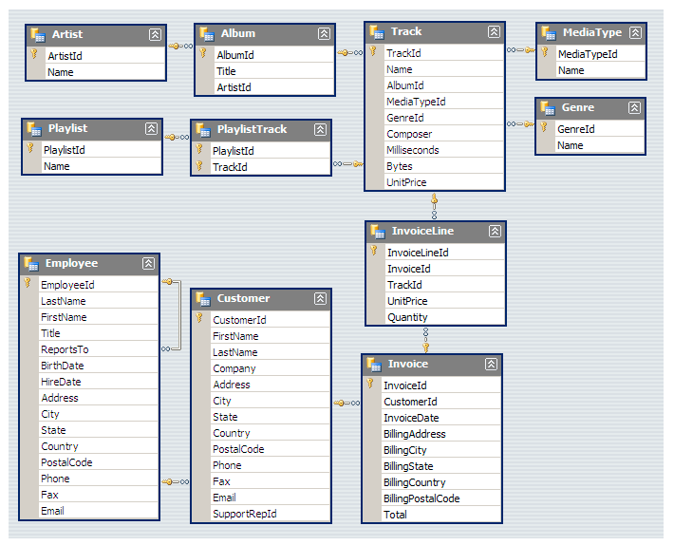
Music Store Analysis
MUSIC STORE DATABASE SCHEMA

Slide 4
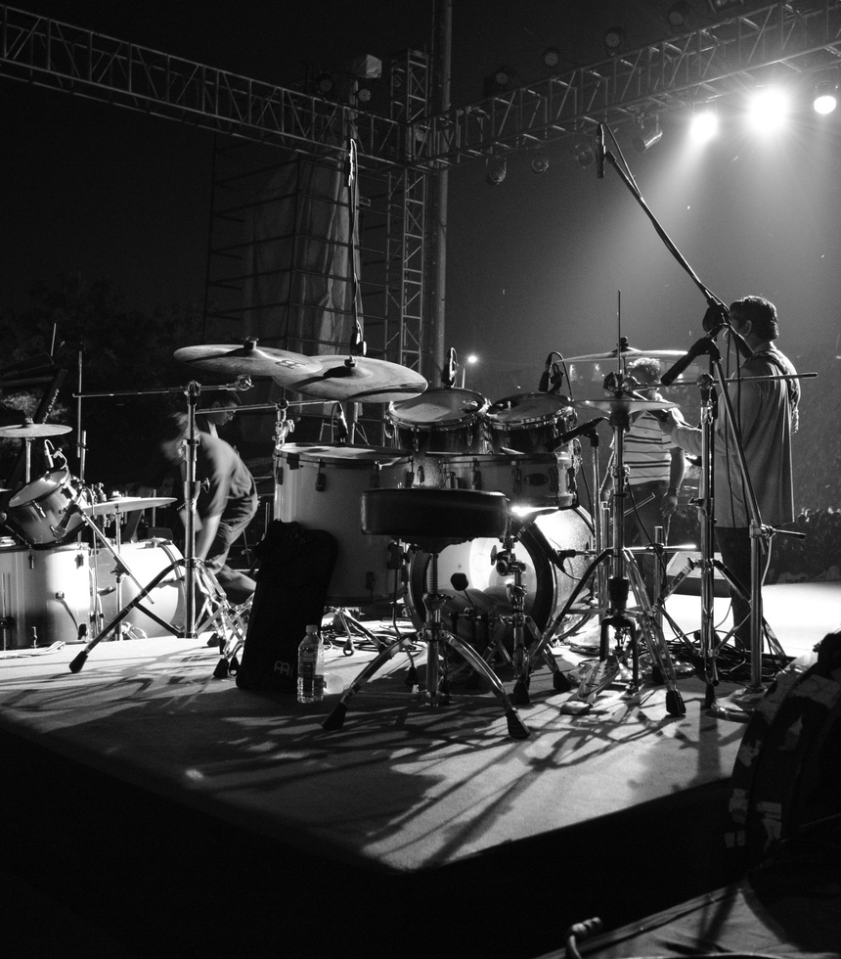
Music Store Analysis
EASY CATEGORY

Slide 5

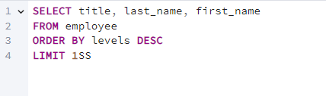

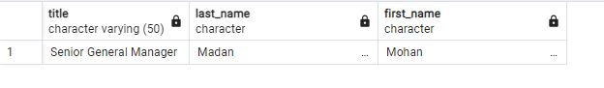
Music Store Analysis
Q1: Who is the senior most employee based on job title?

Slide 6

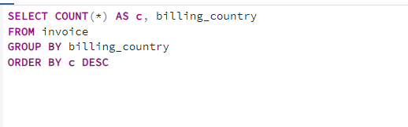
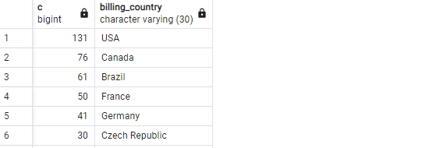
Music Store Analysis
Q2: Which countries have the most Invoices?

Slide 7

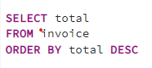

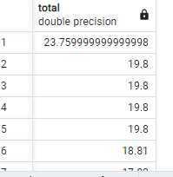
Music Store Analysis
Q3: What are top 3 values of total invoice?

Slide 8

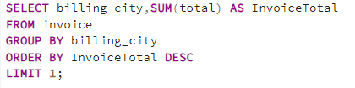
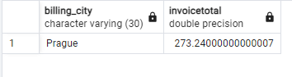
Music Store Analysis
Q4: Which c ity has the best customers? We would like to throw a promotional Music Festival in the city we made the most money.
Write a query that returns one city that has the highest sum of invoice totals.
Return both the city name & sum of all invoice totals

Slide 9
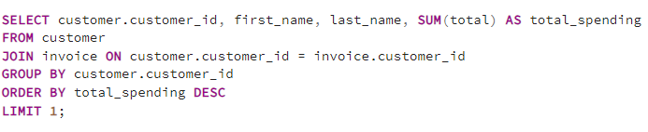
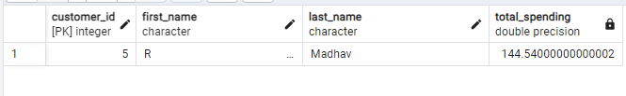
Music Store Analysis
Q5: Who is the best customer? The customer who has spent the most money will be declared the best customer.
Write a query that returns the person who has spent the most money.

Slide 10
Music Store Analysis
MODERATE

Slide 11
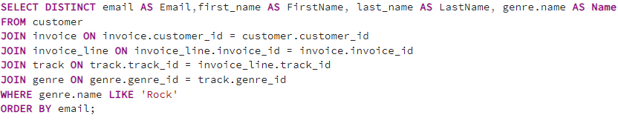
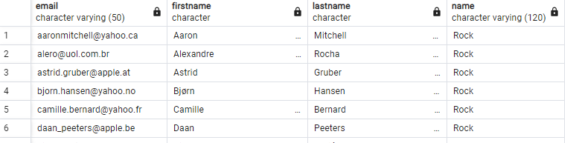
Music Store Analysis
Q1: Write query to return the email, first name, last name, & Genre of all Rock Music listeners.
Return your list ordered alphabetically by email starting with A.

Slide 12
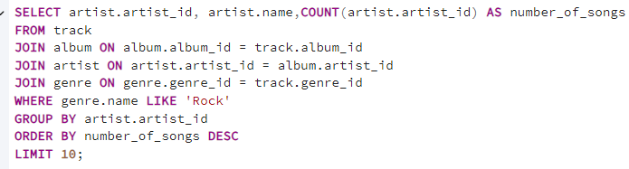
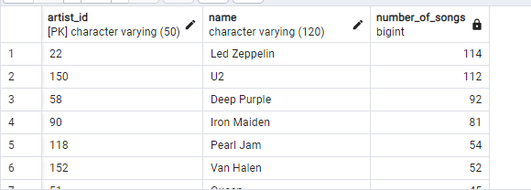
Music Store Analysis
Q2: Let's invite the artists who have written the most rock music in our dataset.
Write a query that returns the Artist name and total track count of the top 10 rock bands.

Slide 13

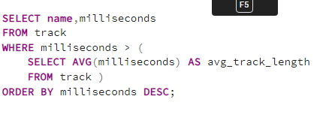
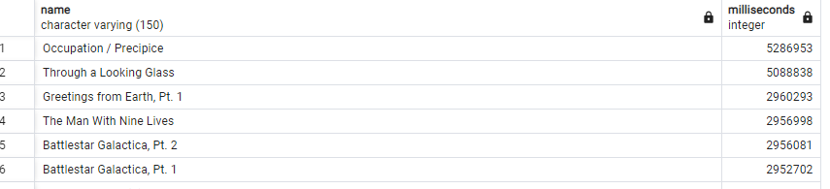
Music Store Analysis
Q3: Return all the track names that have a song length longer than the average song length.
Return the Name and Milliseconds for each track. Order by the song length with the longest songs listed first.

Slide 14

Music Store Analysis
ADVANCE

Slide 15
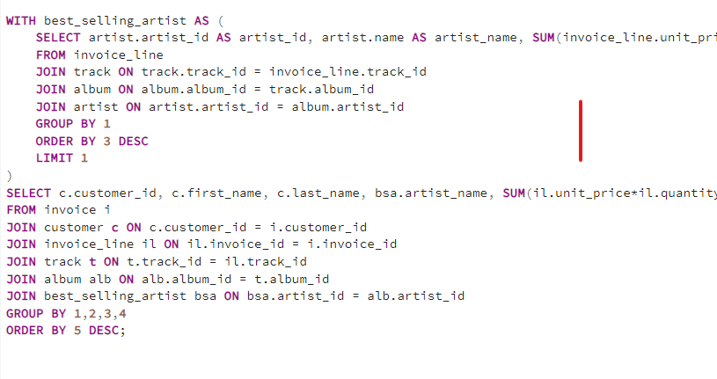
Music Store Analysis
Q1: Find how much amount spent by each customer on artists? Write a query to return customer name, artist name and total spent

Slide 16
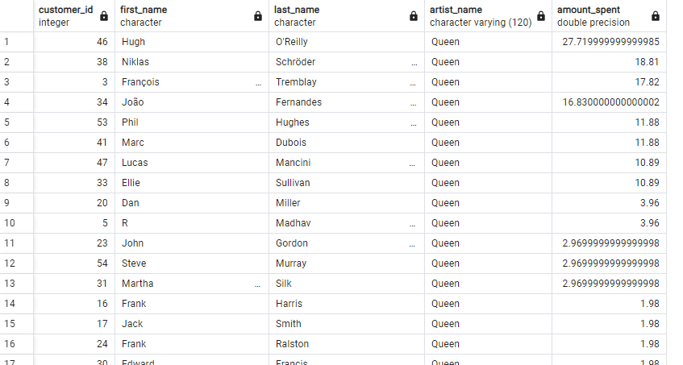
OUTPUT

Slide 17
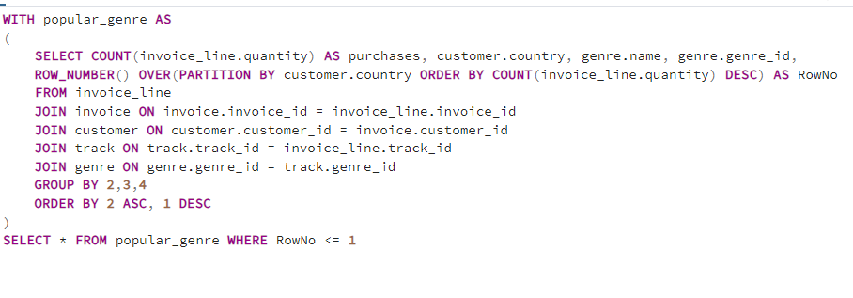
Music Store Analysis
Q2: We want to find out the most popular music Genre for each country. We determine the most popular genre as the genre
with the highest amount of purchases. Write a query that returns each country along with the top Genre. For countries where
the maximum number of purchases is shared return all Genres.

Slide 18
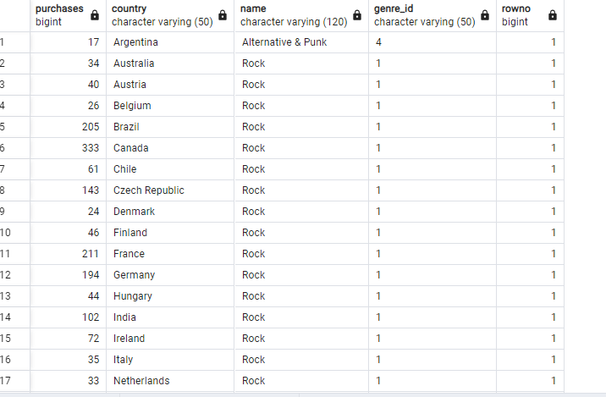
OUTPUT

Slide 19
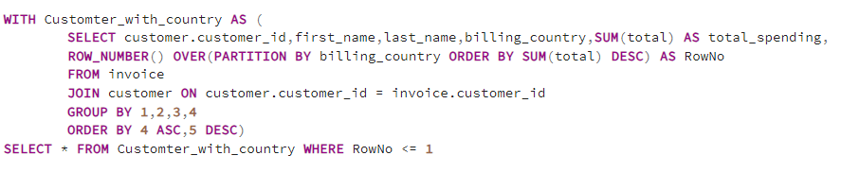
Music Store Analysis
Q3: Write a query that determines the customer that has spent the most on music for each country.
Write a query that returns the country along with the top customer and how much they spent.
For countries where the top amount spent is shared, provide all customers who spent this amount.

Slide 20
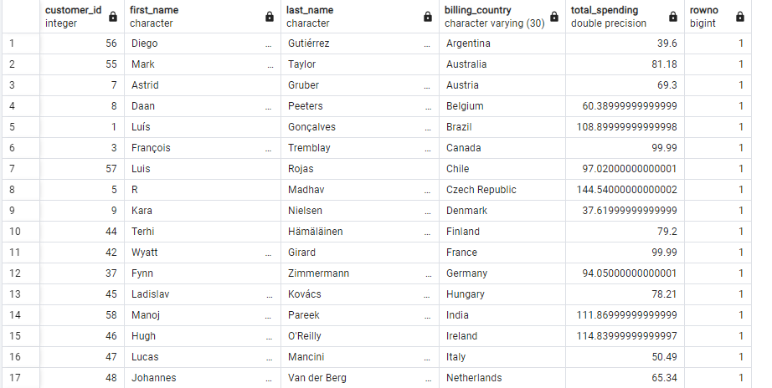
OUTPUT

Slide 21

Music Store Analysis
THANK YOU

